Slide 2
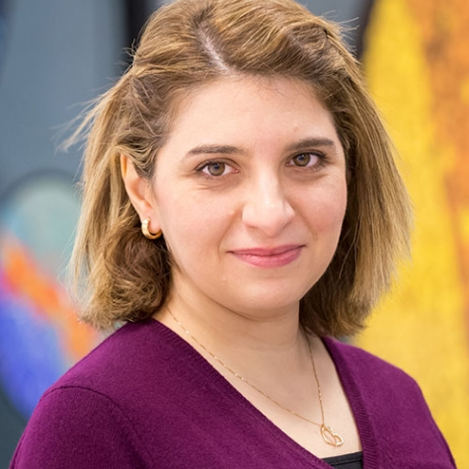
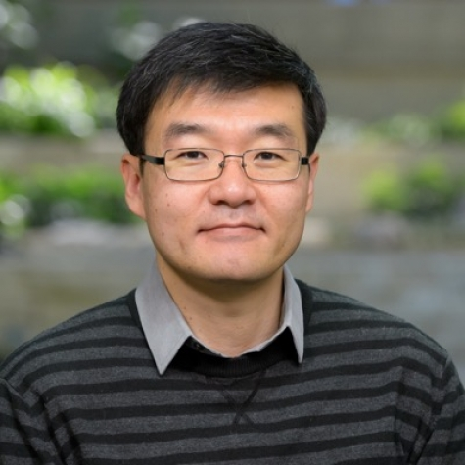
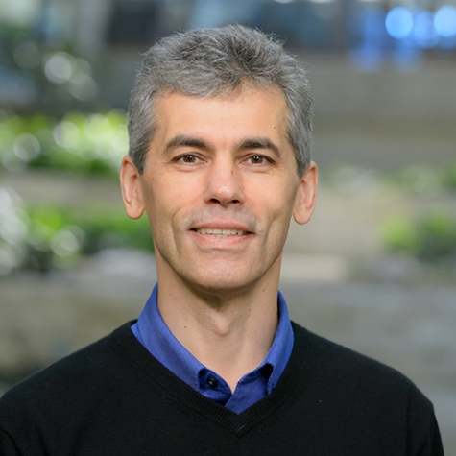
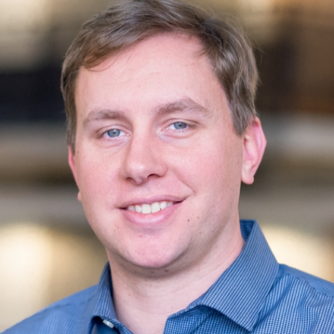
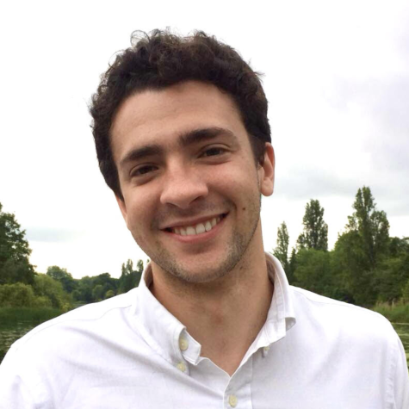
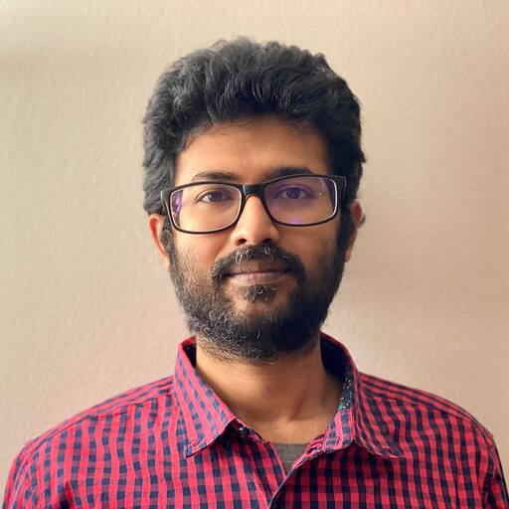
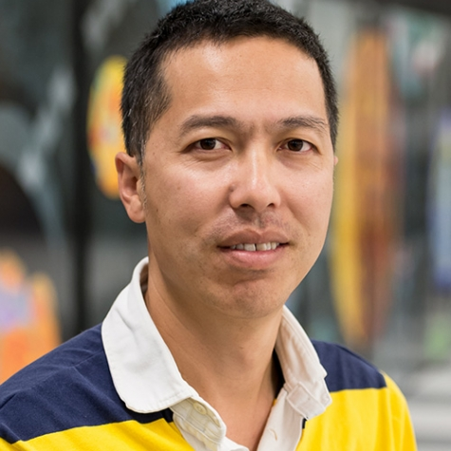
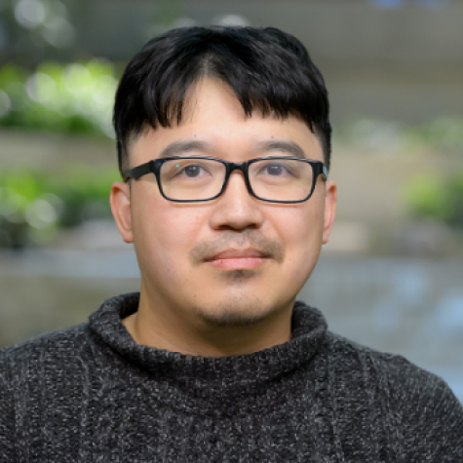
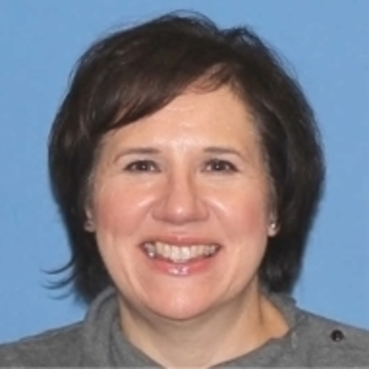
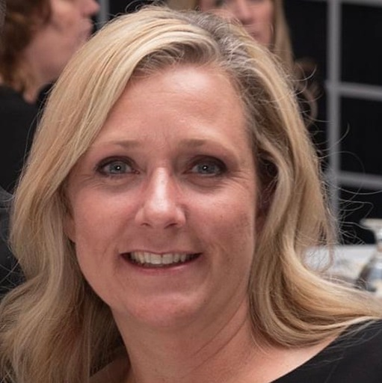
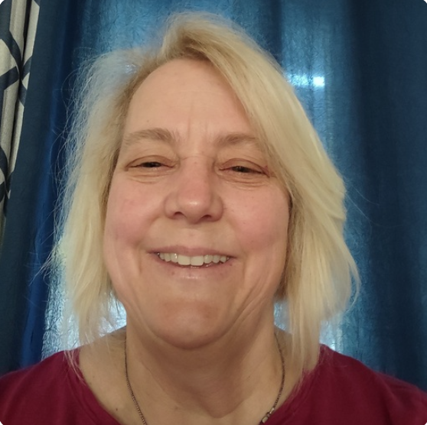
2025 ALCF Hands-on HPC Committee
Yasaman Ghadar
Victor Anisimov
Brain Homerding
Riccardo Balin
Khalid Hossain
JaeHyuk Kwack
Support Team
Wei Jiang
Hyeondeok Shin
Kathy Gorgan
Tracy Lozano
Jennifer Banis
Johnny Marquez

Slide 3
Safety

Slide 7
How to get support during the workshop?
Slack
Look for folks with yellow badge
Ask at the expert table

Slide 8
Machine Reservation
Aurora
The project is –A alcf_training
To run on small number of nodes (up to 8) for Aurora use –q alcf_training
To run up to 1024 nodes on Aurora use –q alcf_training_l
Polaris
The project is –A alcf_training
1-2 nodes per user use –q alcf_training
To run up to 128 nodes on Polaris use –q alcf_training_l

